Slide 1
The Third Agruculture
Agriculture

Slide 2
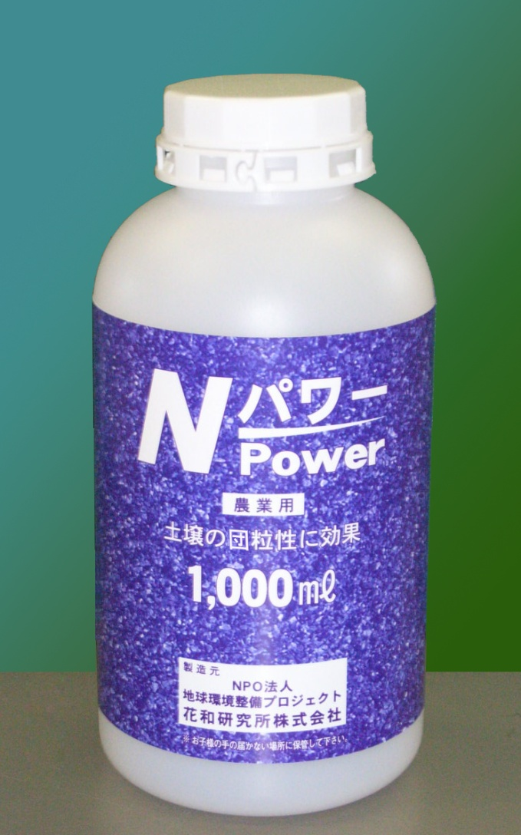
“The third agriculture” with N Power
By use of N Power,
Soil balance is improved as result of the increase of bacterias due to decomposition to low molecular in early stage.
- N Power activates and create bacterias in soil.
Agricultural products with better taste in safe and reliable way.

Slide 3
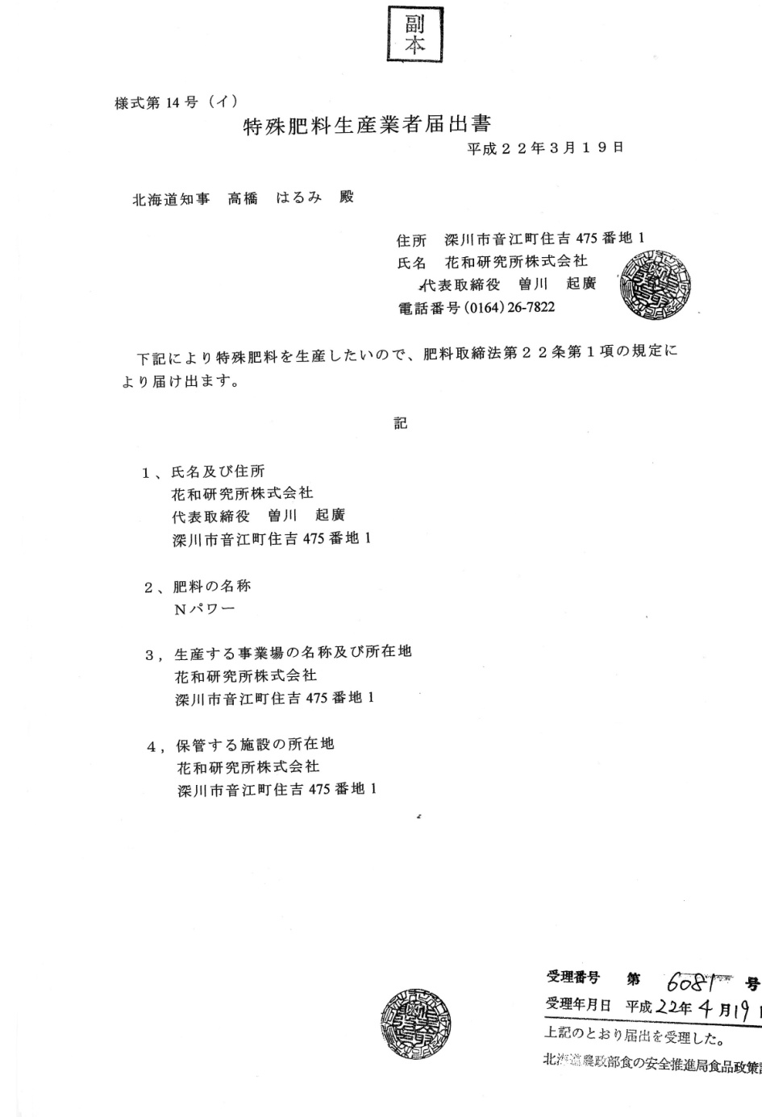
Register to the authority of the
Hokkaido prefecture as
Special fertilizer manufacturer.
All the tests for its sefety in
use have been verified.

Slide 4
Certificate of analysis
of soil, issued by an
official laboratory.
Residue of Tiram (mortal
poison : agricultural
chemical)
Soil with N power shows
that in 48 hours, the con-
tent of Tiram deceases to
almost zero.

Slide 5
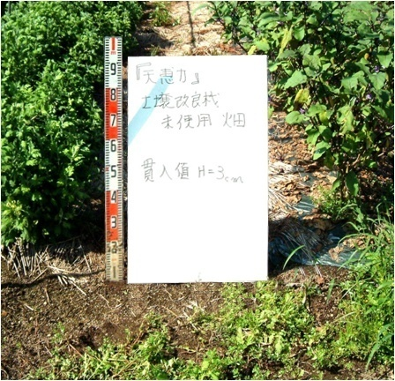
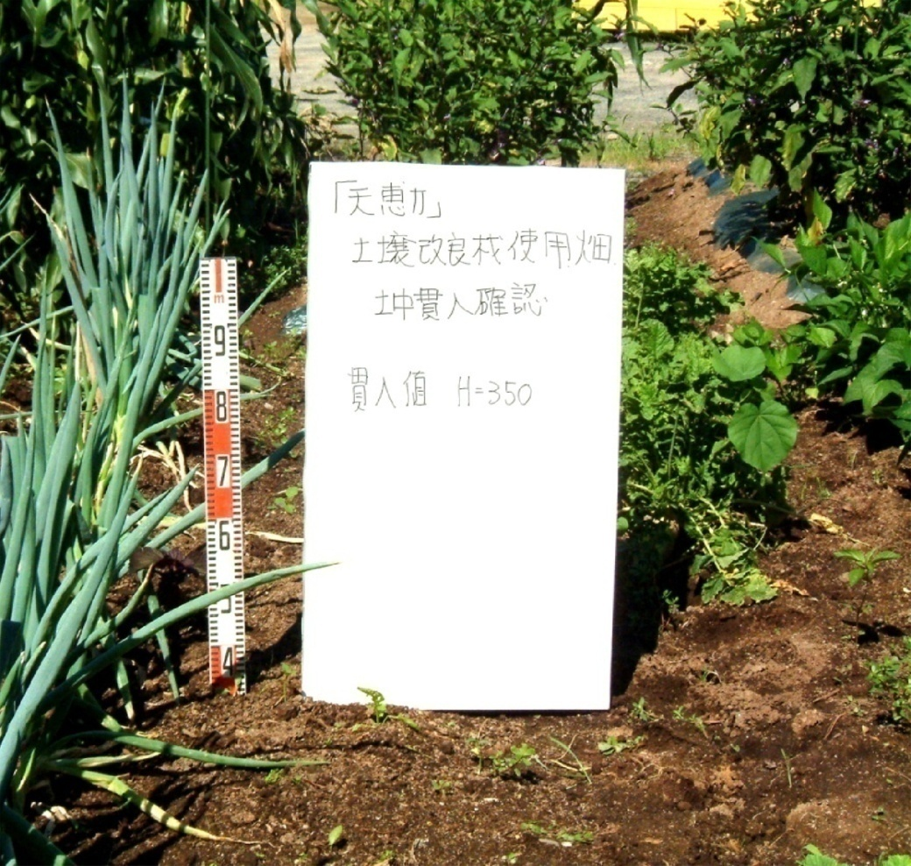
Soil improved with N power
(acid soil)
(Neutralized soil)
H= 3 cm
H= 35 cm
Soil softened with grains

Slide 6
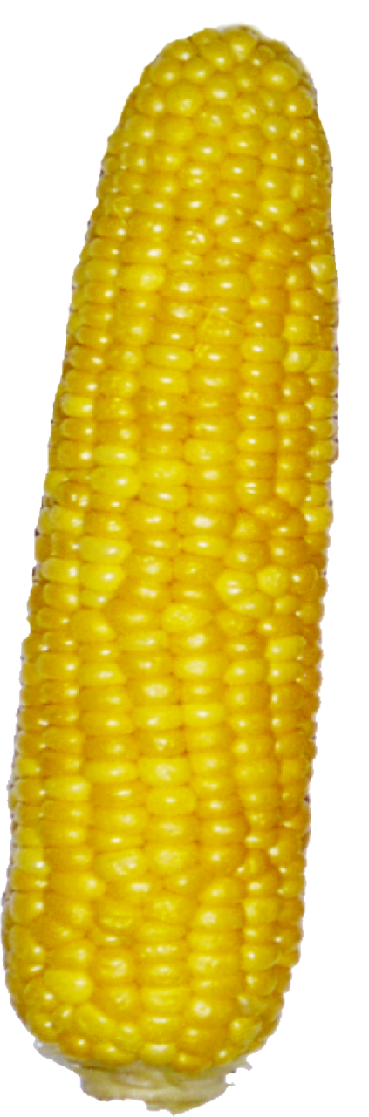
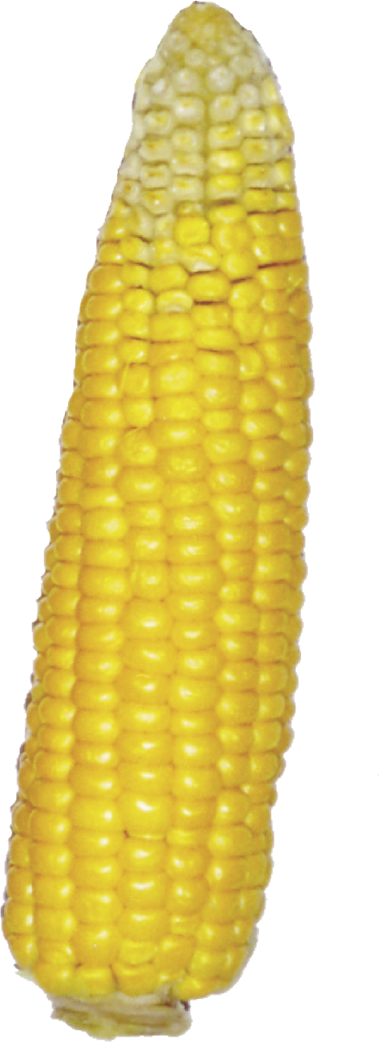
Normal
Third agriculture

Slide 7
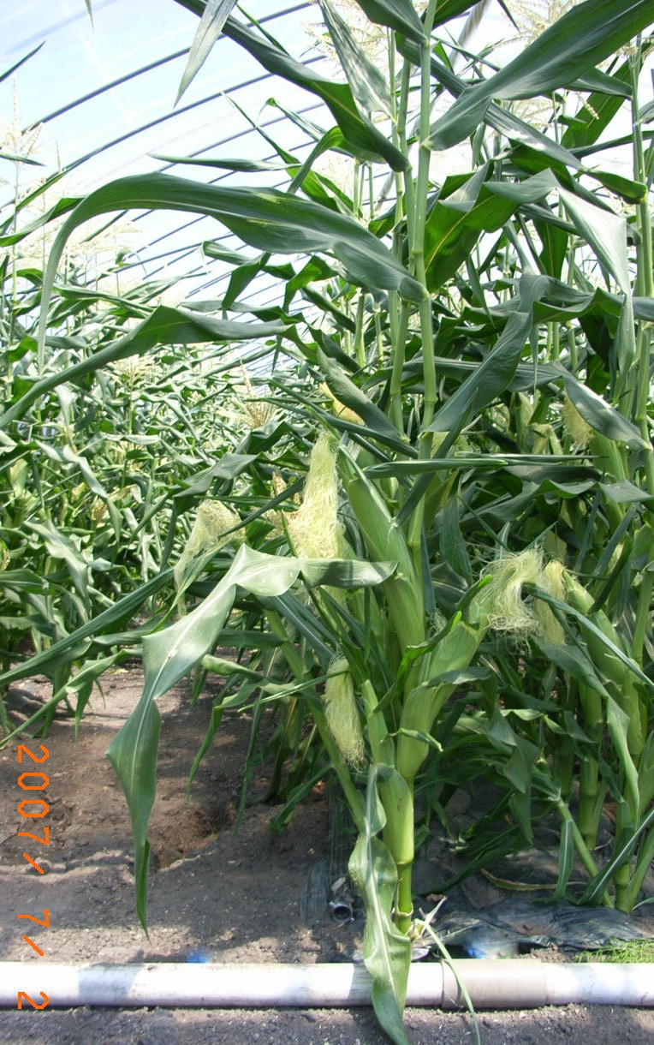
Three cones in a stalk

Slide 8
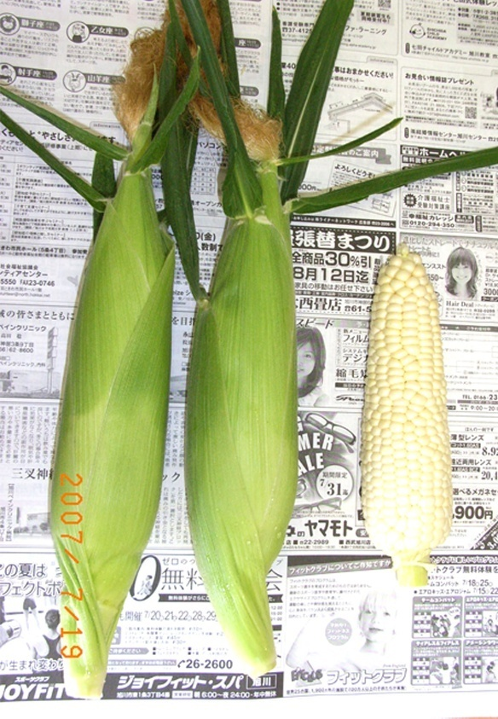
Cones “pure white”
cultivated by Third
Agriculture method
Sugar content
: 20

Slide 9
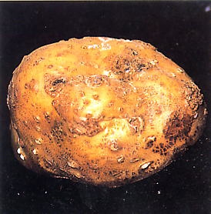
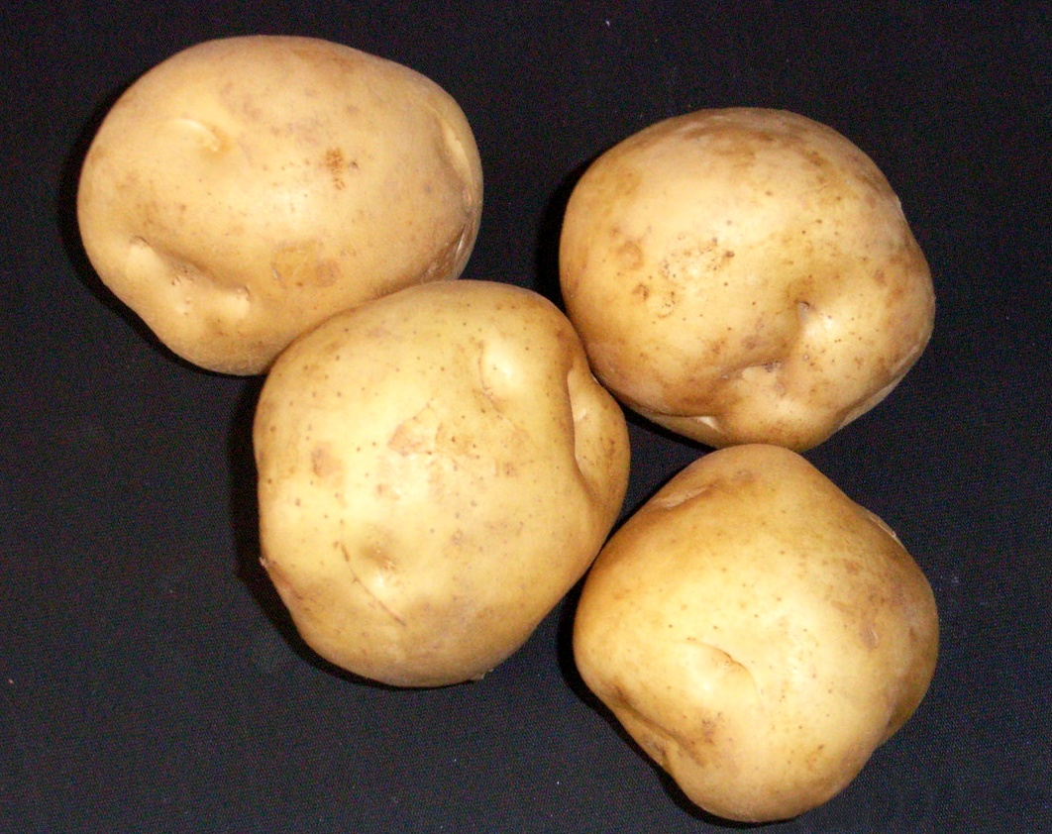
Prevention of common scab by the third agriculture
Potato common scab
The third agricuture improves the soil

Slide 10
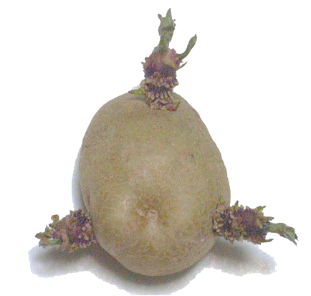
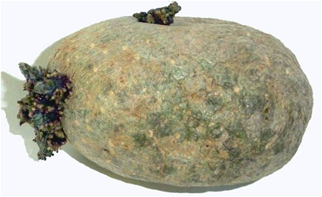
Tercera agricultura
Big buds
Normal
Small buds

Slide 11
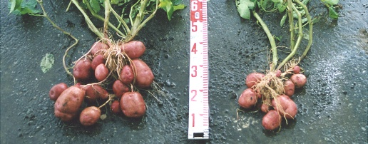
Absortion of the three elements (N. P, K)
In the conventional agricuture, the three elements are not decomposed in small size, while in the third agriculture, thiese three elements (nitrogen, phosphoric acid y potassium) are decomposed in small size in early stage, making its absortion easy by agricultural products.

Slide 12
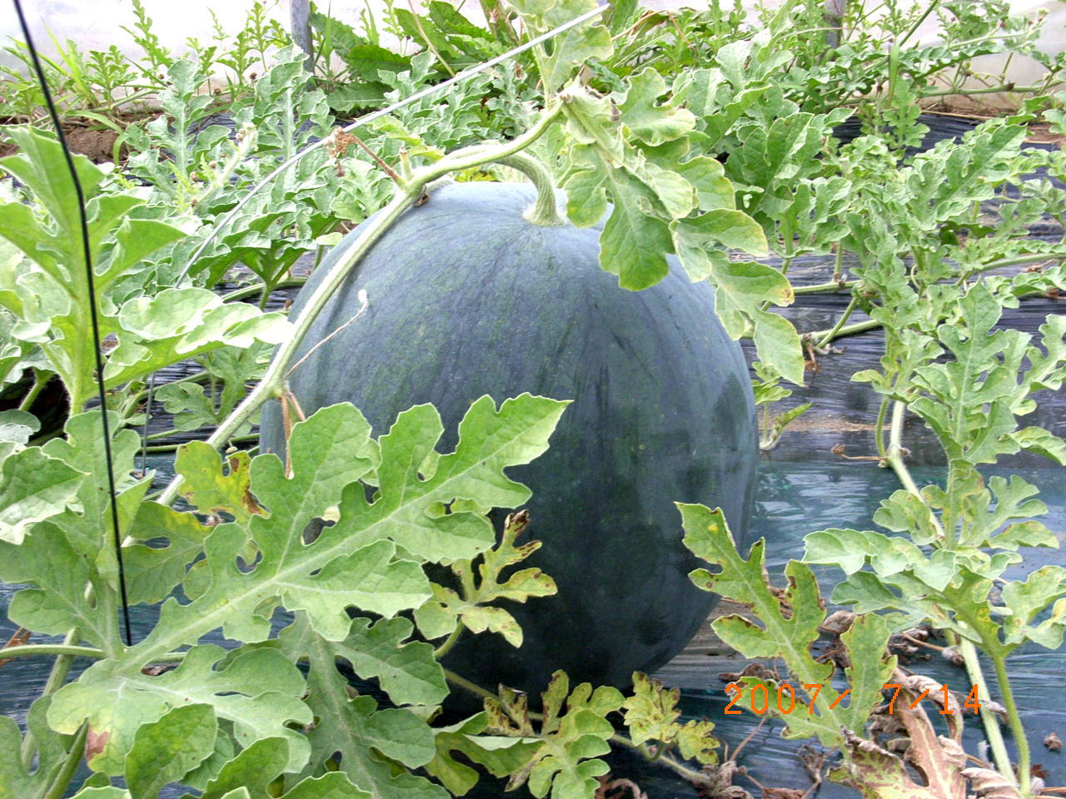
Water melon “densuke” of Toma, Hokkaido (third agriculture)
Premium by the minister de agriculture, forestry & fishery

Slide 13
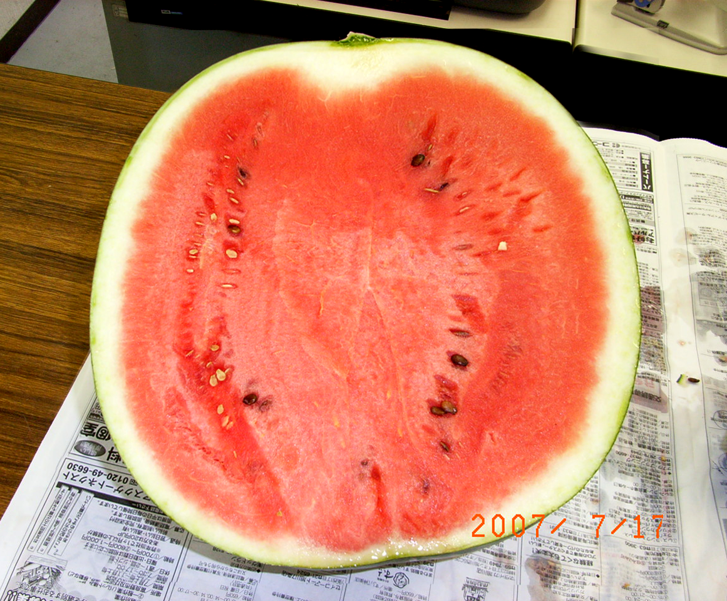
Water melon “densuke” of Toma, Hokkaido

Slide 14
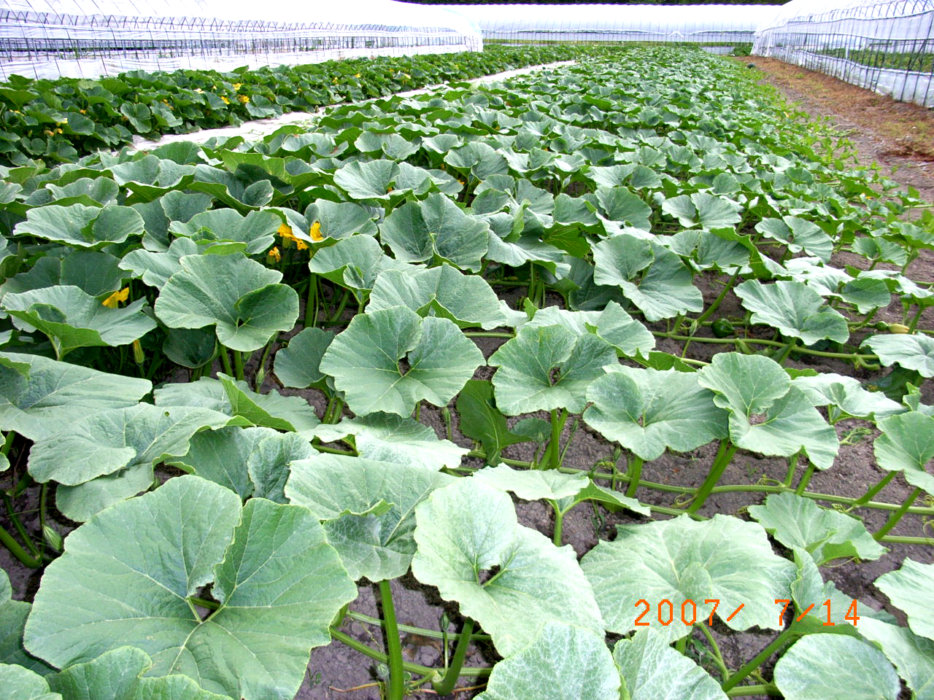

Slide 15
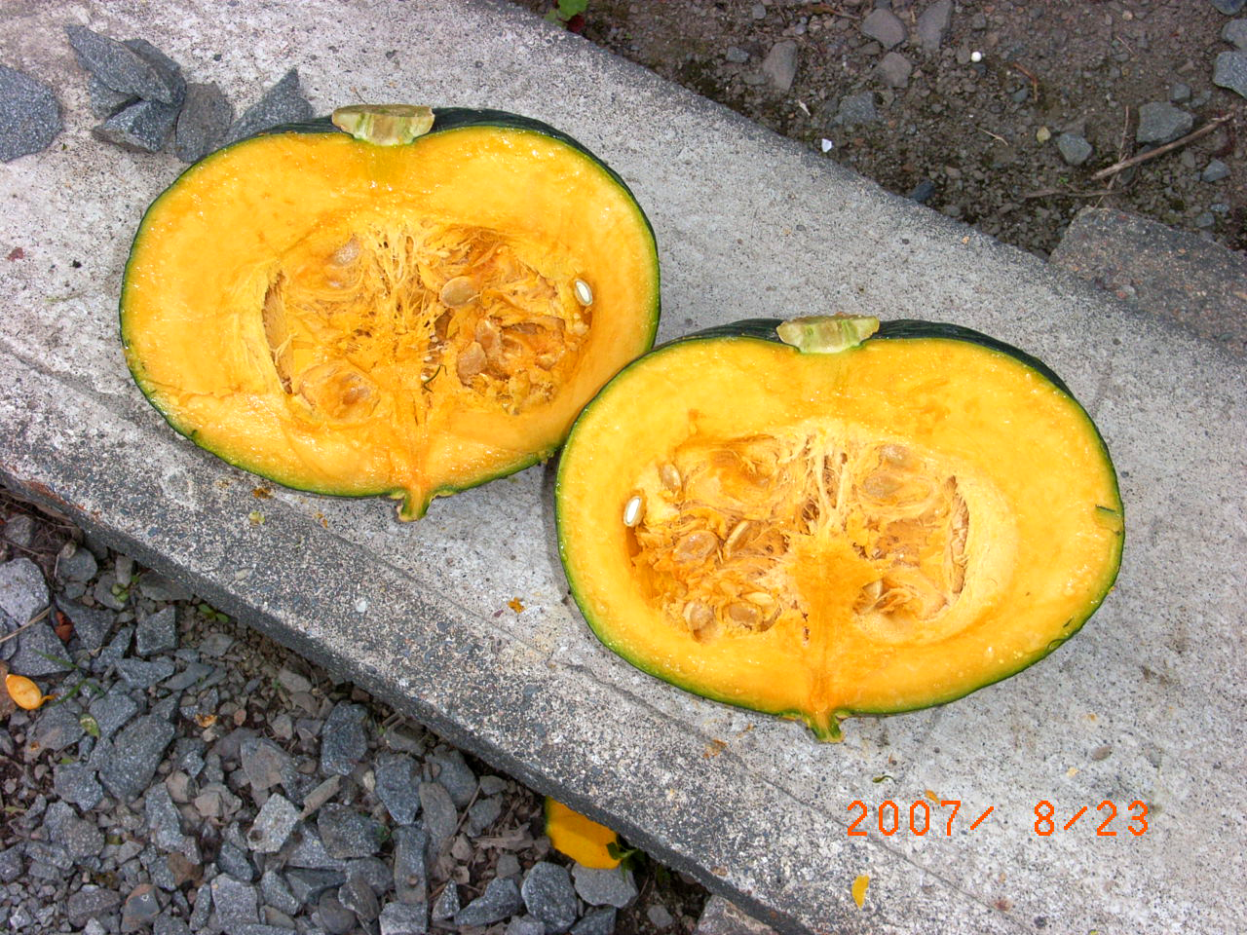
Sugar content: 16-20 degrees

Slide 16
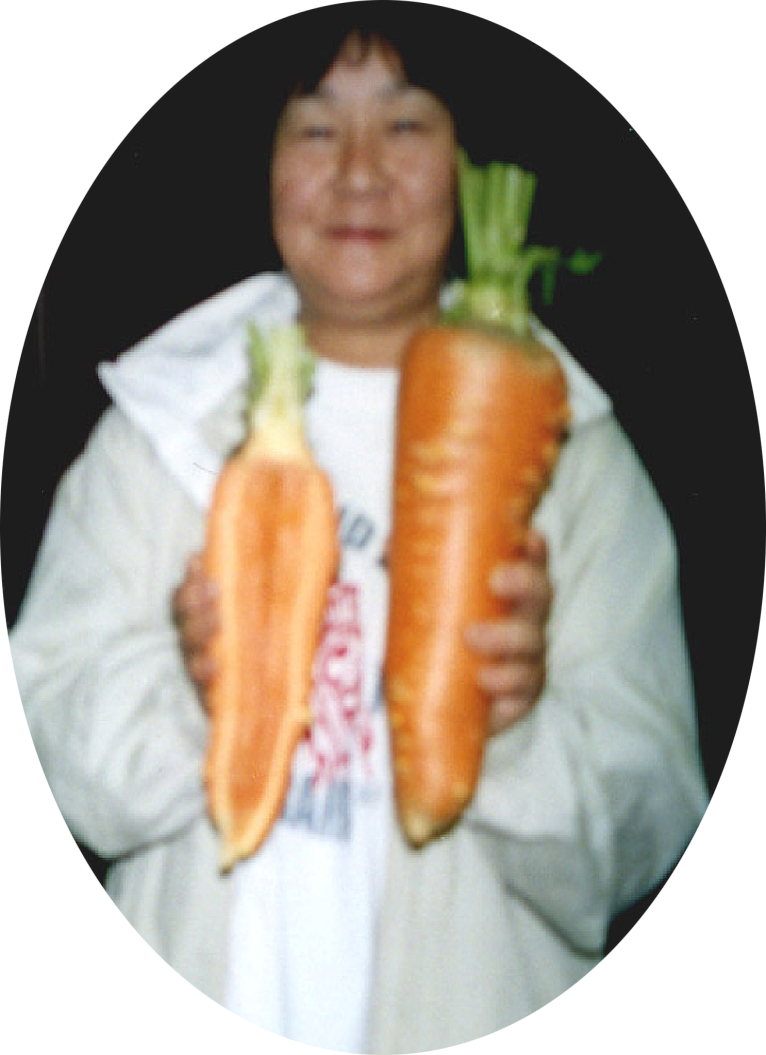
Carrot, big but
But no holes
inside

Slide 17
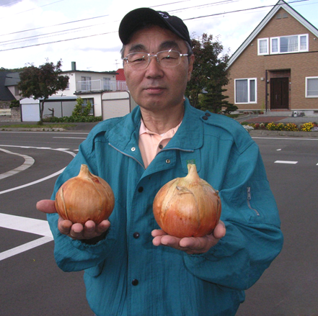
Onions, big and heavy, also sweet

Slide 18
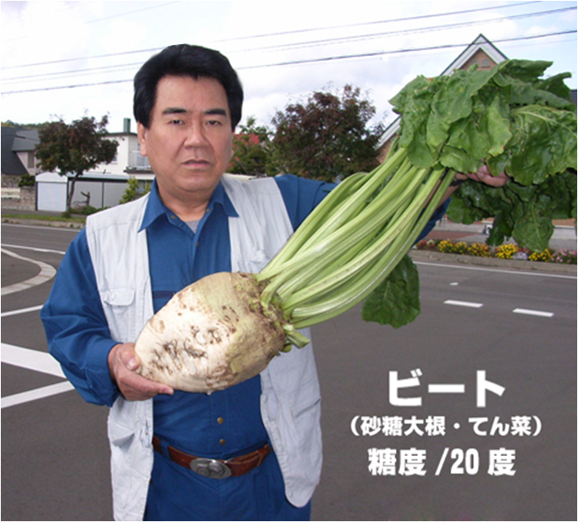
Sugar beet
Sugar content: 20 degrees

Slide 19
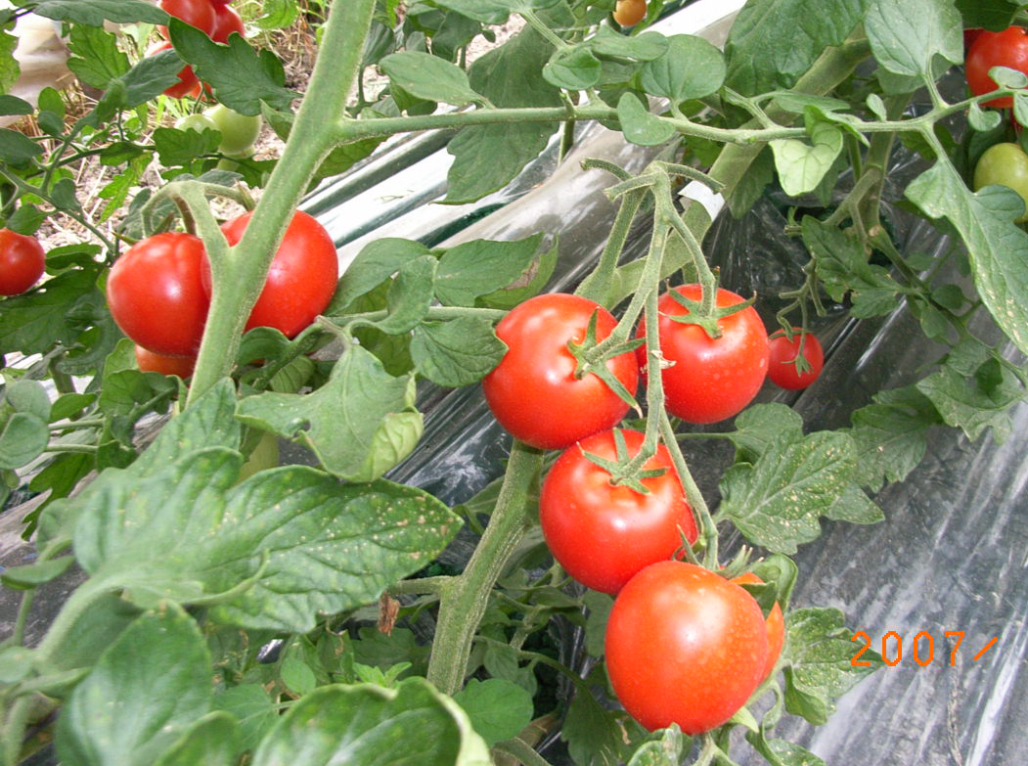

Slide 20
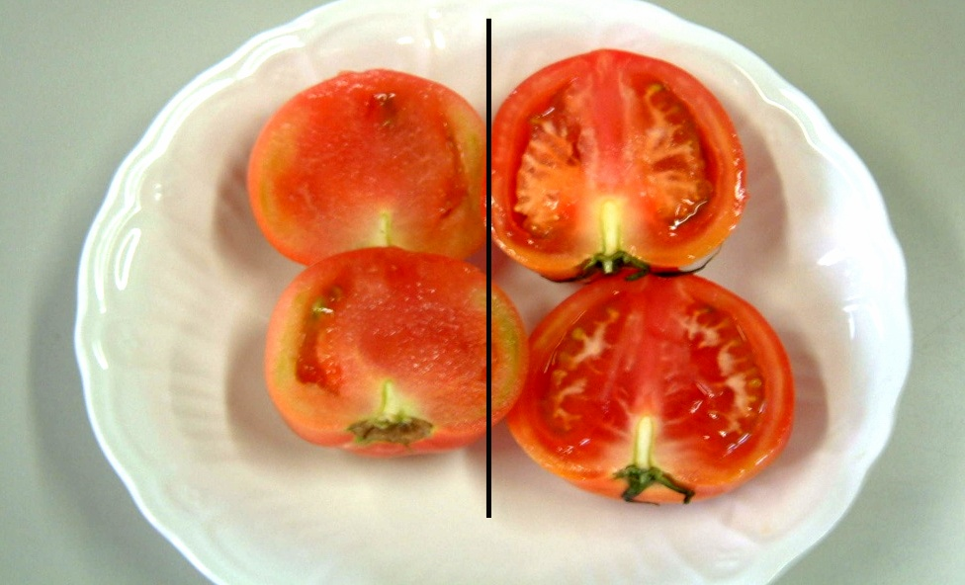
Third agriculture
Conventional

Slide 21
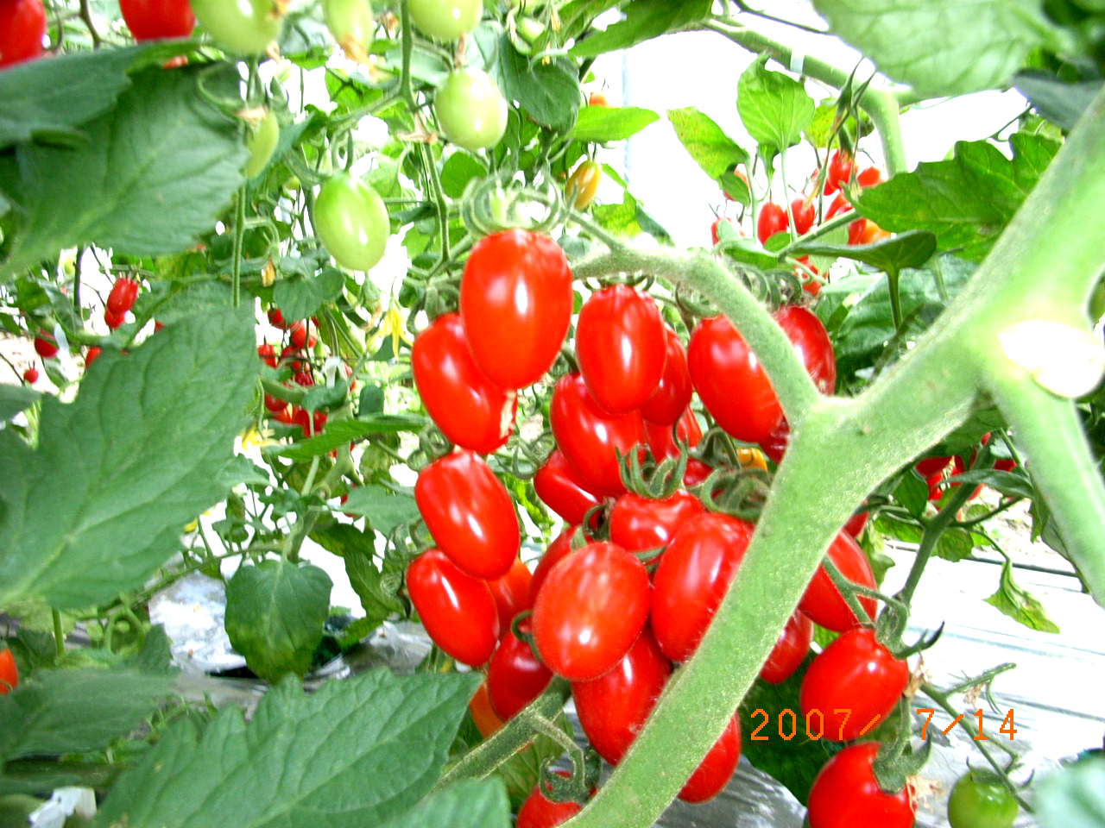
Mini Tomato “Kirara”

Slide 22
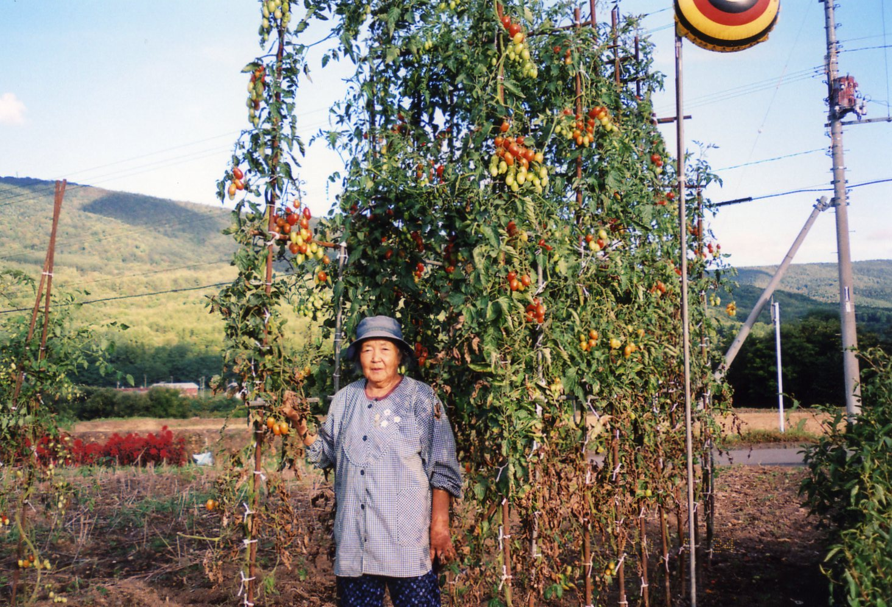
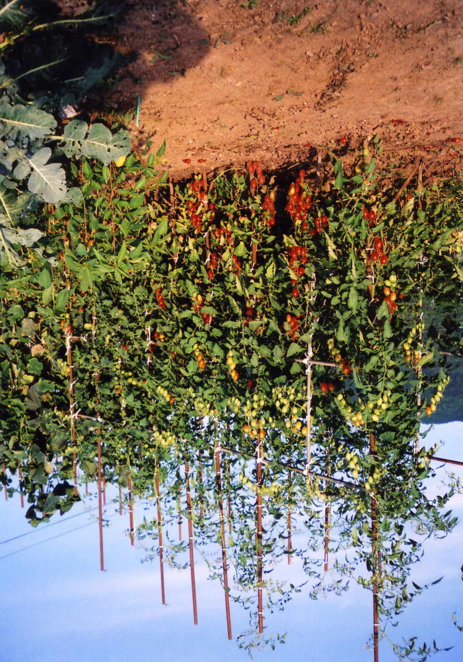
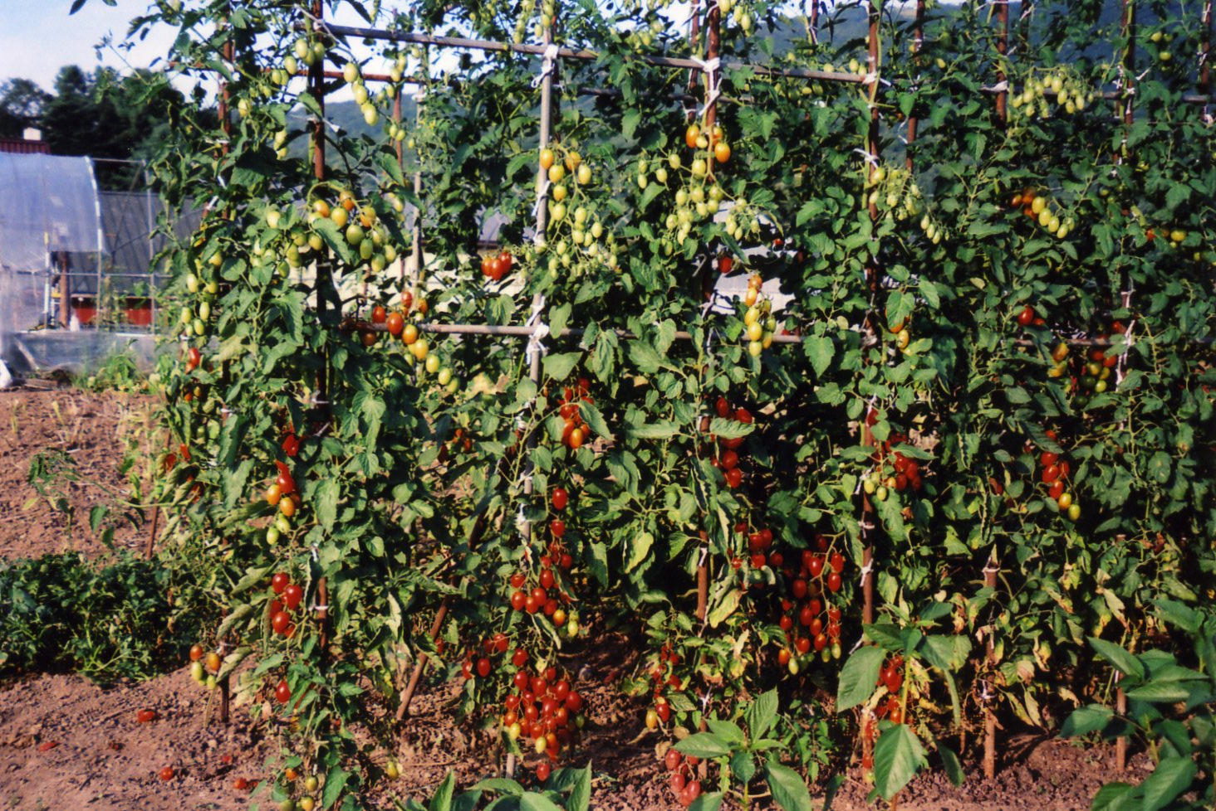
Up to 6 meters hight

Slide 23
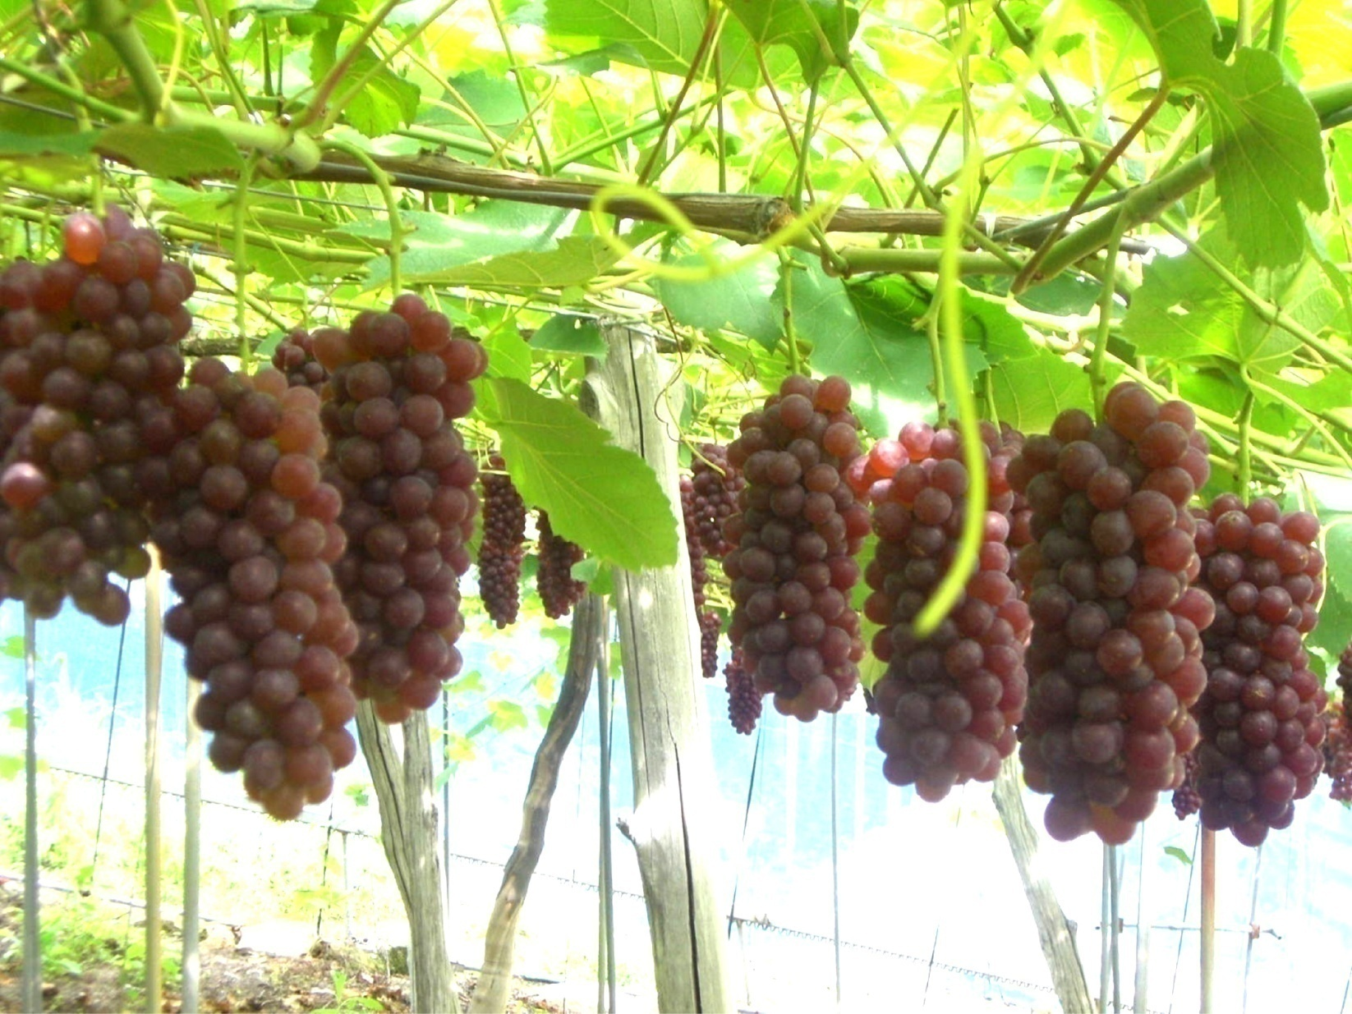
Farm in Yamagata prefecture

Slide 24
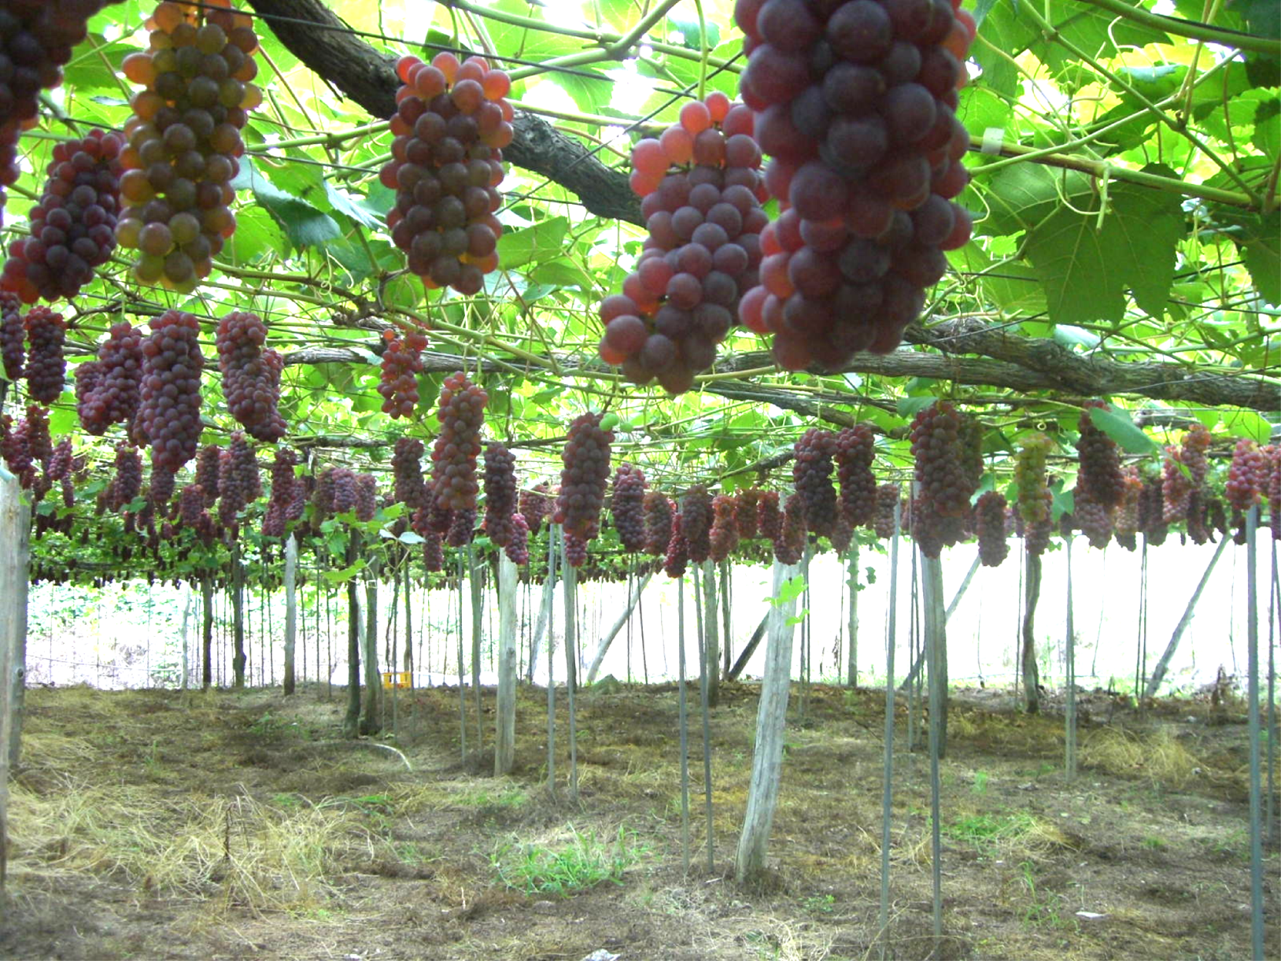
Uniform quality and form

Slide 25
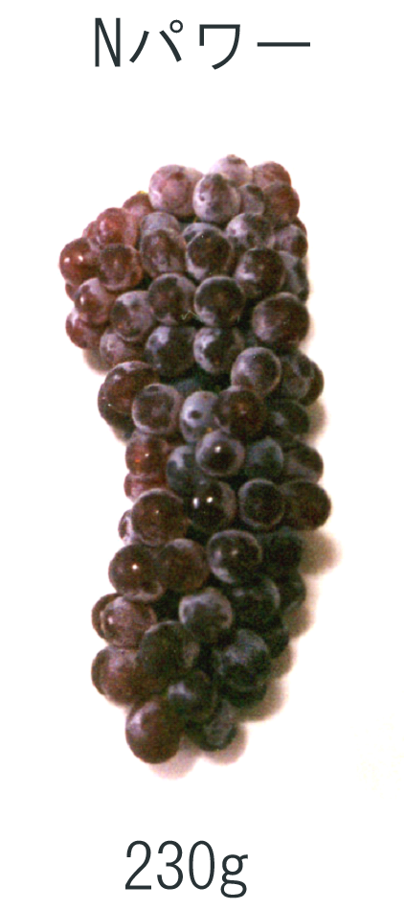
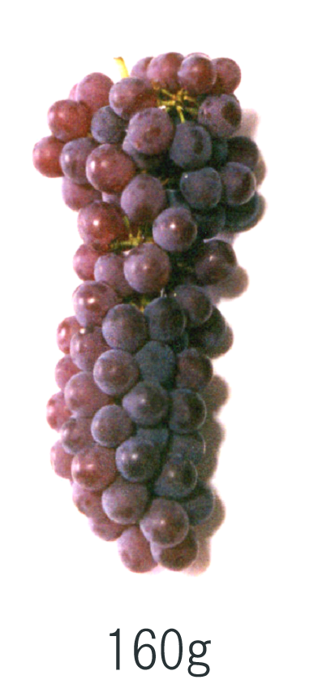
Conventional
Third agriculture
Sugar content is
also increased

Slide 26
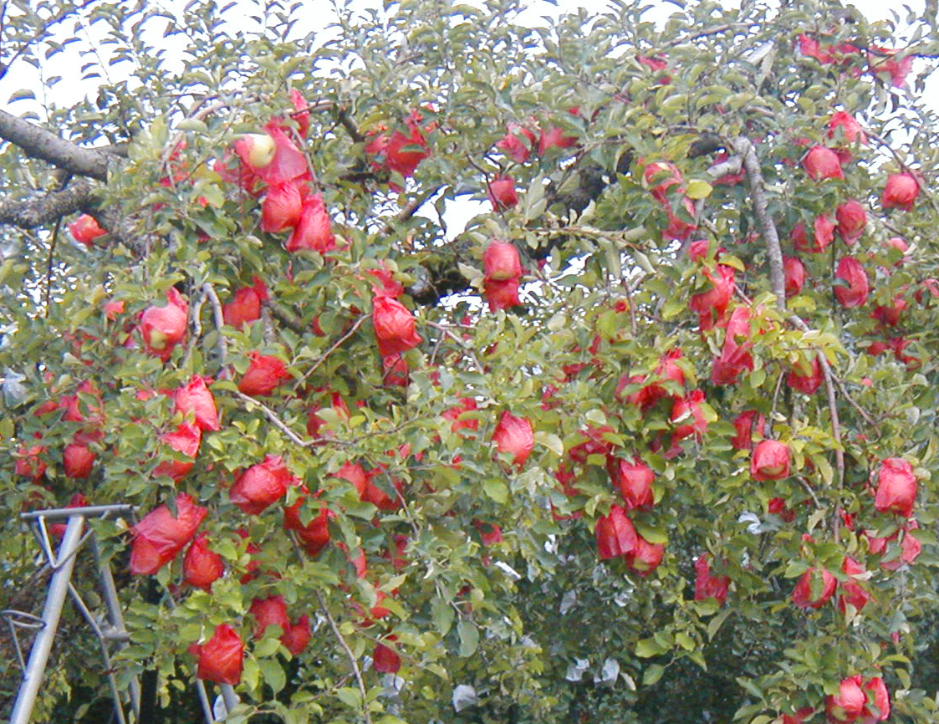

Slide 27
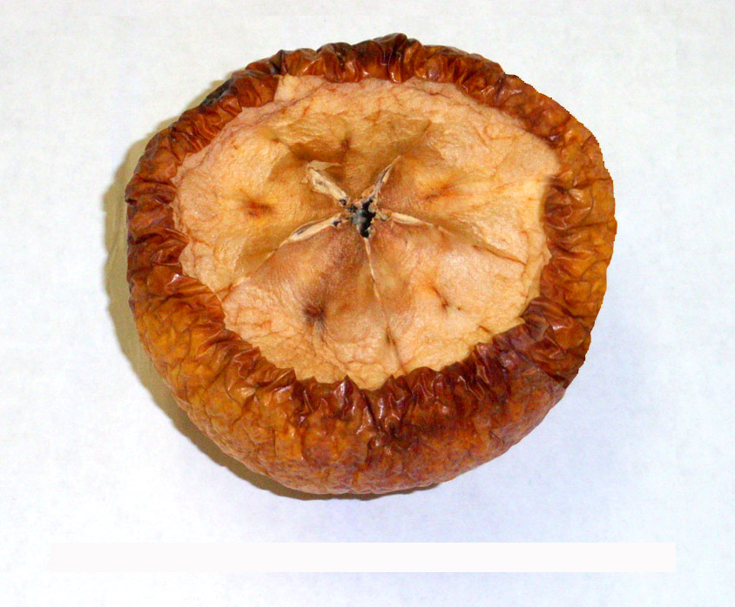
Japanese persimmon after 6 mmonths under room temperature

Slide 28
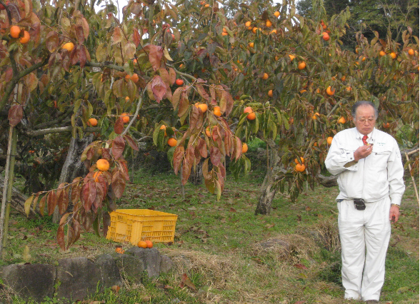
Japanese persimmon farm in Tottori prefecture

Slide 29
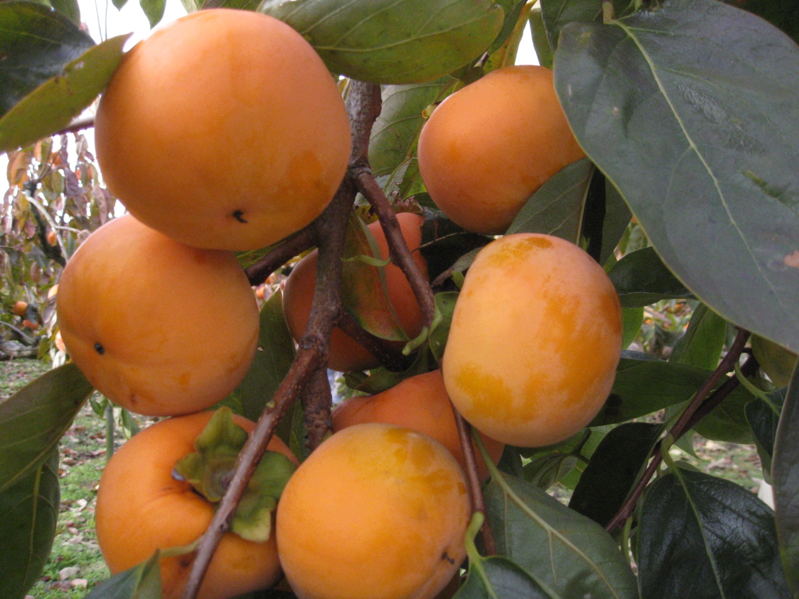
Sugar content at harvest: 20 degrees, after maturing: 23.5 degrees

Slide 30
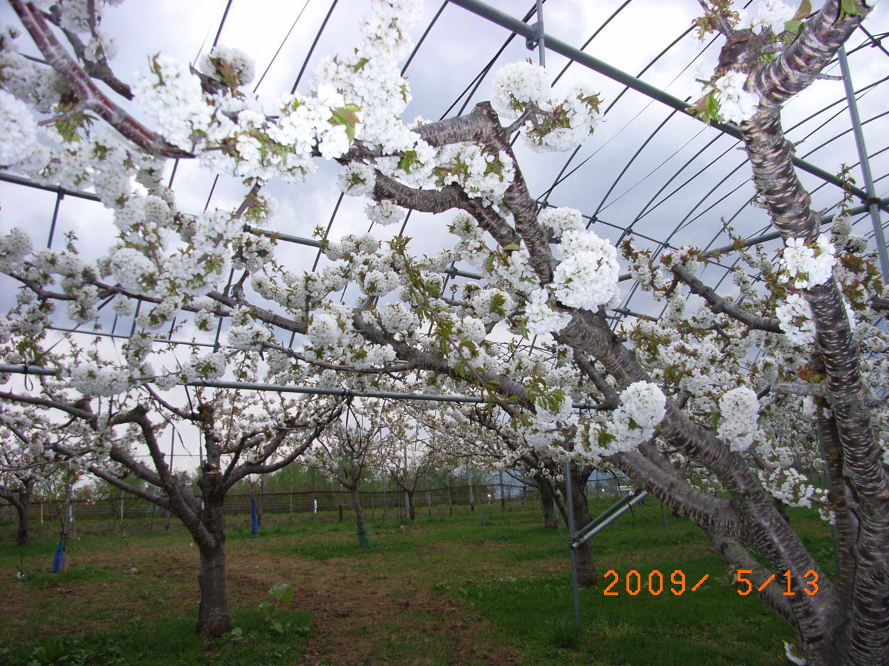

Slide 31
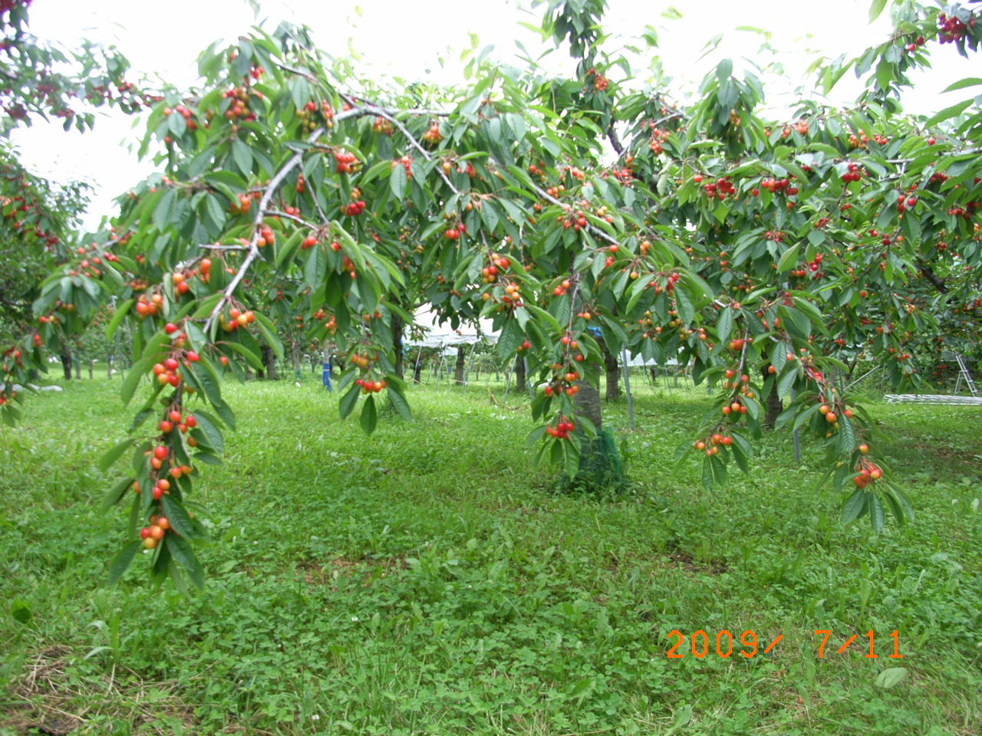

Slide 32
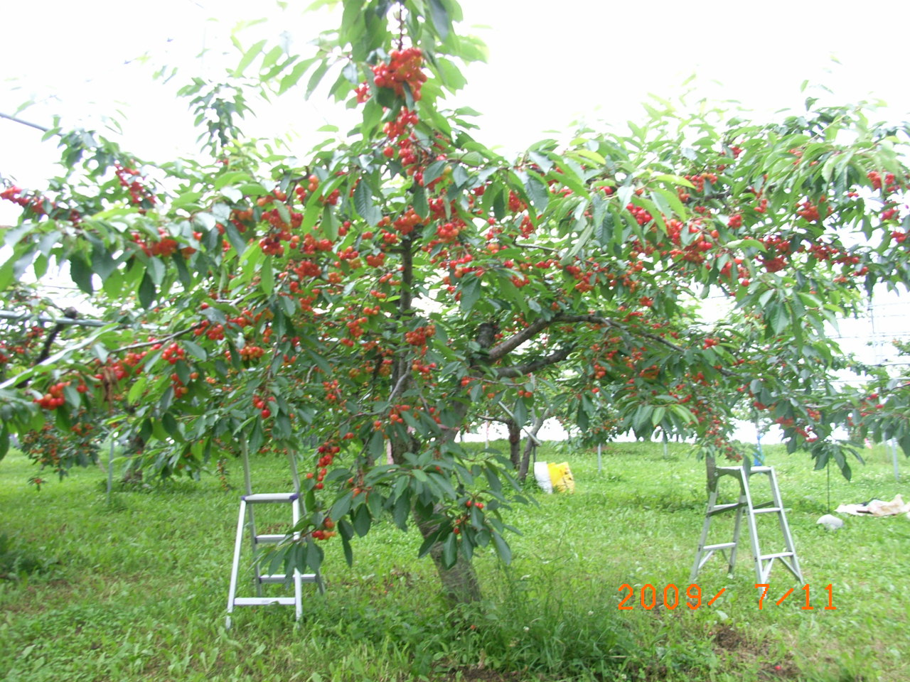

Slide 33
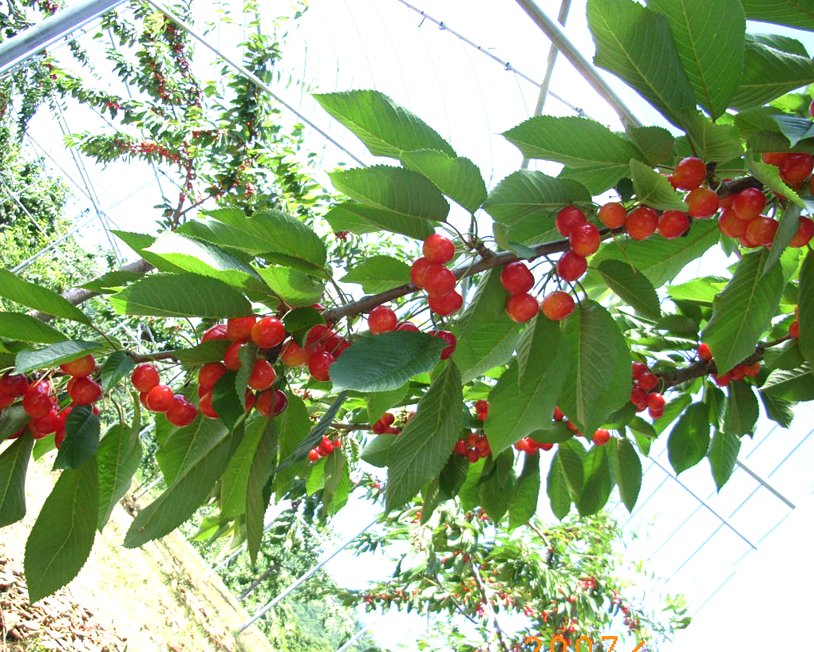
Cherry farm “sato nishiki”

Slide 34
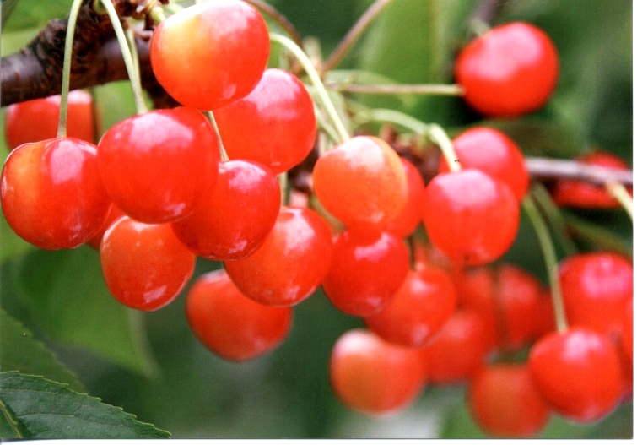

Slide 35
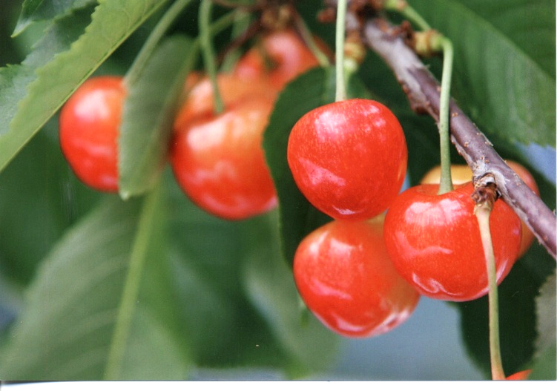

Slide 36
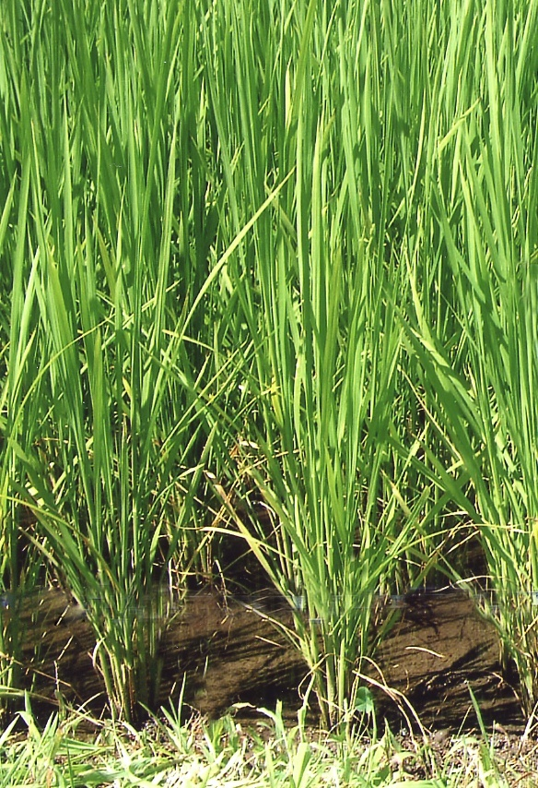
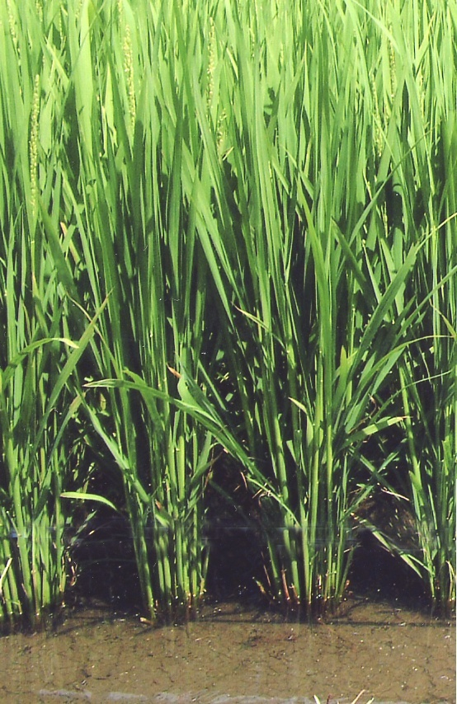
Rice
Conventional
Third agriculture

Slide 37
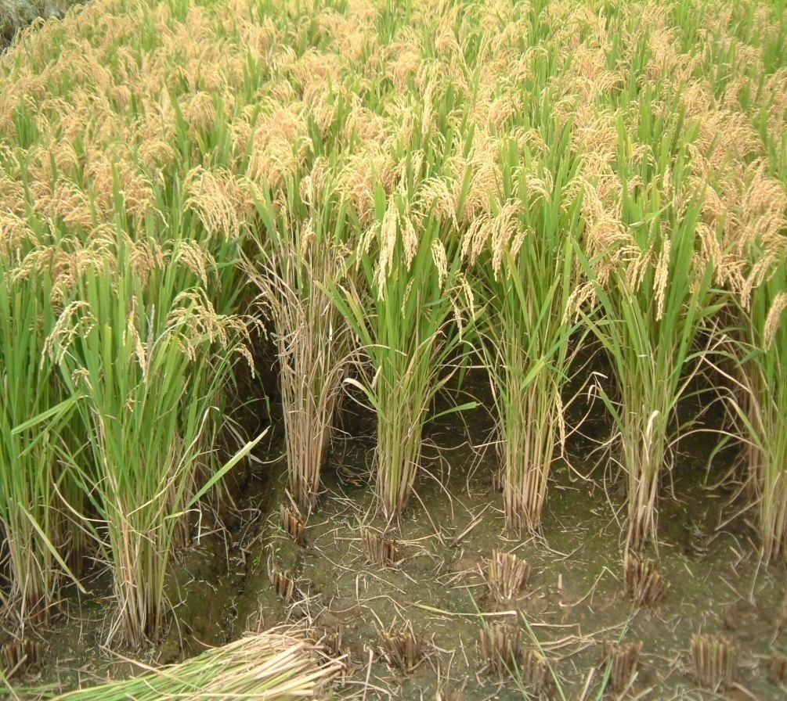
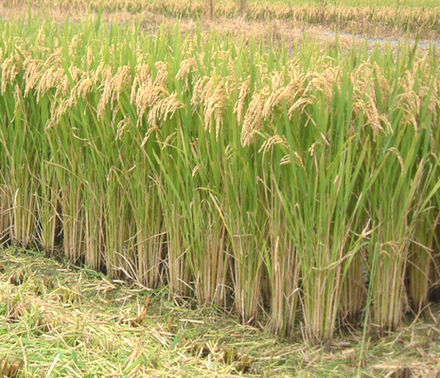
Producer of low-amylose rice
Conventional
Sheath blight desease
Third agriculture
No sheath blight desease

Slide 38
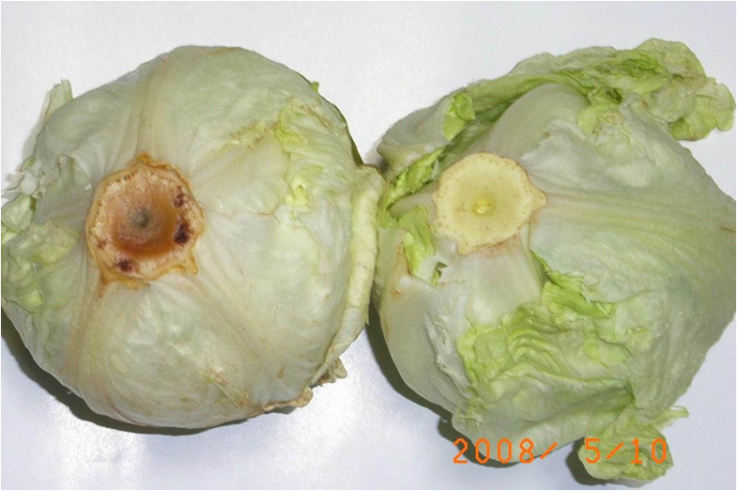
Conventional
Third agriculture

Slide 39
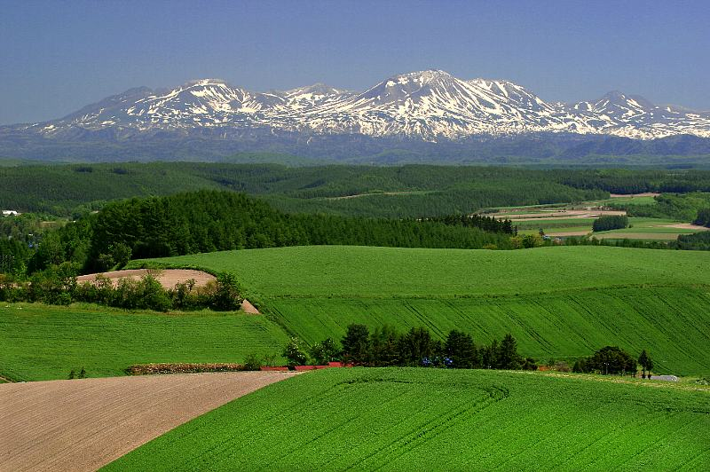
Agriculture
Innovation with the third agriculture
Decomposition of protein in low molecules in early stage activates and increases good bacterias. This is the first step to obtain soil balance.

Slide 40
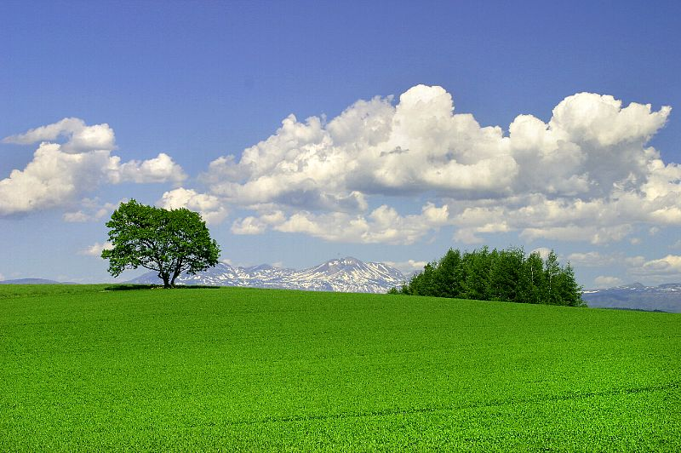
Back to the natural and original soil

